Slide 1
Spatial and Temporal Patterns of Carbon Storage and Flux in PNW Forests: 1972-2008
David Wallin¹
Peter Homann¹
Mark Harmon²
Warren Cohen³
Robert Kennedy²
Olga Krankina²
¹Western Washington University, Bellingham, WA; david.wallin@wwu.edu
²Oregon State University, Corvallis, OR
³USDA Forest Service, Corvallis, OR

Slide 2
Why is the global carbon cycle important?
All life on the planet is based upon the cycling of carbon

Slide 3
Carbon Cycling
Photosynthesis and respiration are among the most important mechanisms controlling the global carbon cycle
Photosynthesis
6CO₂ + 12H₂0 Life 6O₂ + C₆H₁₂O₆ + 6H₂0
Respiration
Plants use CO₂ from the atmosphere as a source of both C and O for the production of glucose (C₆H₁₂O₆), with H₂0 providing the necessary H

Slide 4
Carbon Cycling
Glucose (C₆H₁₂O₆) is the central carbohydrate compound of protoplasm, and carbohydrates constitute a large percentage of the total dry biomass of plants. Glucose is composed of:
6 atoms of C; atomic wt = 12 72
6 atoms of O; atomic wt = 16 96
12 atoms of H; atomic wt = 1 12 ---- 180

Slide 5
Carbon Cycling
Glucose (C₆H₁₂O₆) is the central carbohydrate compound of protoplasm, and carbohydrates constitute a large percentage of the total dry biomass of plants. Glucose is composed of:
6 atoms of C; atomic wt = 12 72
6 atoms of O; atomic wt = 16 96
12 atoms of H; atomic wt = 1 12 ---- 180
So, (72 + 96)/180 = 0.93
93% of the mass of the glucose molecule is derived directly from air!
From CO₂ in the air

Slide 6
Carbon Cycling
Plants, and animals, are composed of more than just C, O, and H; other important elements include N, P and K….and a few other elements
Nevertheless, about half of the dry biomass of plants is composed of C and this C is derived entirely from the atmosphere.

Slide 7
Why is the global carbon cycle important?
All life on the planet is based upon the cycling of carbon
Atmospheric concentrations of CO₂ have increased substantially over the past century or so, largely as a result of the combustion of fossil fuels

Slide 8
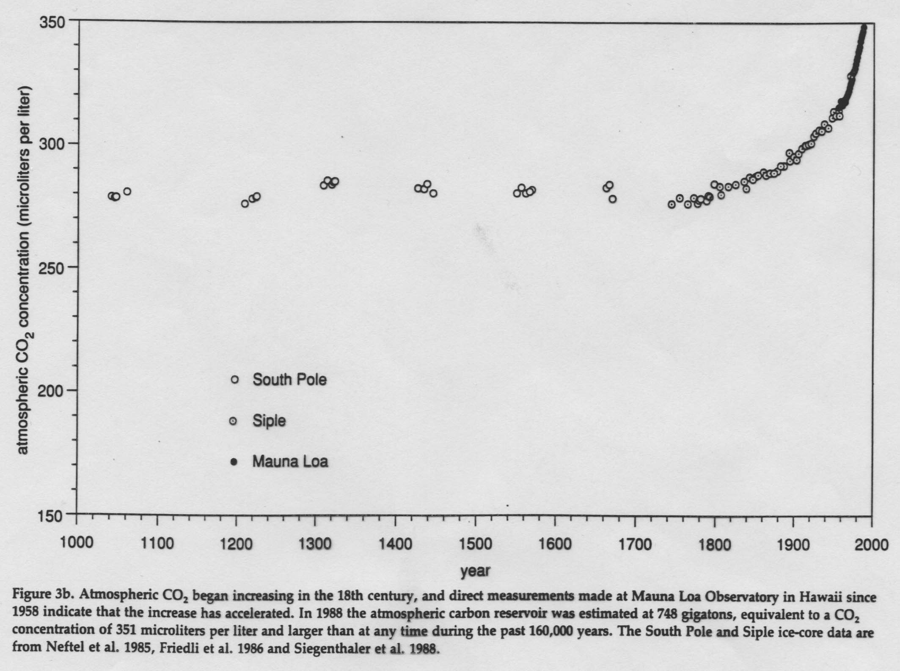
Recent trends in atmospheric CO₂ concentrations: The role of fossil fuel burning

Slide 9
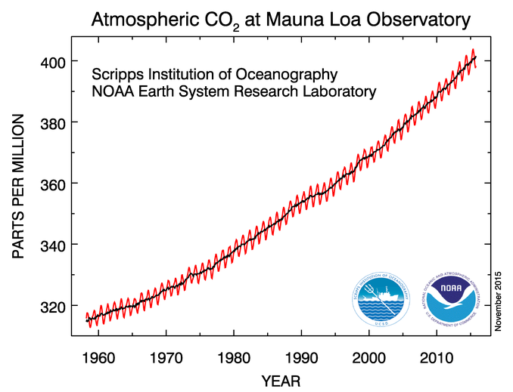
Even more recent records reveal that atmospheric CO₂ concentrations continue to increase
Current atmospheric CO2 level is ~415 ppm
Notes:
Annual variation in CO2 levels correspond to seasonal variation in photosynthetic rate. In N hemisphere, CO2 levels decline during the summer growing season and increase during the winter months.
Source: http://www.esrl.noaa.gov/gmd/ccgg/trends/

Slide 10
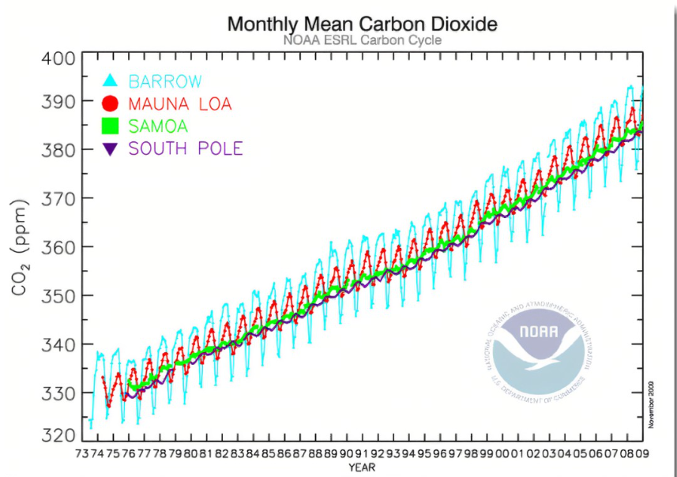
Even more recent records reveal that atmospheric CO₂ concentrations continue to increase
Current atmospheric CO2 level is ~415
ppm
Notes:
Annual variation in CO2 levels correspond to seasonal variation in photosynthetic rate. In N hemisphere, CO2 levels decline during the summer growing season and increase during the winter months.
Source: http://www.esrl.noaa.gov/gmd/ccgg/trends/

Slide 11
Why is the global carbon cycle important?
All life on the planet is based upon the cycling of carbon
Atmospheric concentrations of CO₂ have increased substantially over the past century or so, largely as a result of the combustion of fossil fuels
CO₂ is a “greenhouse gas” and, as such, increasing atmospheric concentrations of CO₂ have the potential to cause major changes in the earth’s climate

Slide 12
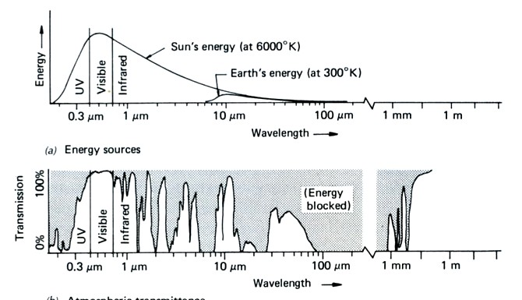
A “Greenhouse Gas”; What does this mean?
Greenhouse gasses absorb EM energy very strongly at wavelengths (8-10 um) where the earth is emitting EM energy to space. This results in a warming of the atmosphere.
Energy inputs from sun
Energy emitted from earth’s surface
Atmospheric Transmission

Slide 13
A “Greenhouse Gas”; What does this mean?
Greenhouse gasses absorb EM energy very strongly at wavelengths (8-10 um) where the earth is emitting EM energy to space. This results in a warming of the atmosphere.
CO2 and other greenhouse gasses absorb strongly in this part of the spectrum, hence trapping more heat in the atmosphere
Energy inputs from sun
Energy emitted from earth’s surface
Atmospheric Transmission

Slide 14
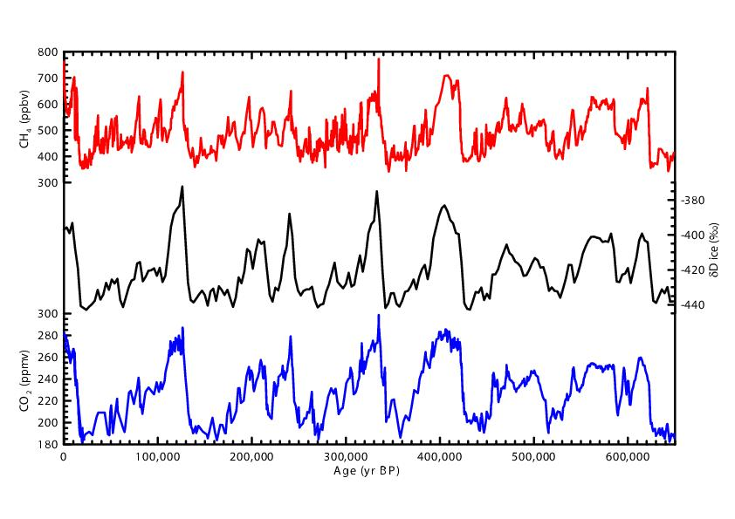
Long-term variation in atmospheric CO₂ concentrations: Antarctic ice cores
Temperature
Notes:
Figure from:
http://www.realclimate.org/index.php/archives/2005/11/650000-years-of-greenhouse-gas-concentrations/

Slide 15
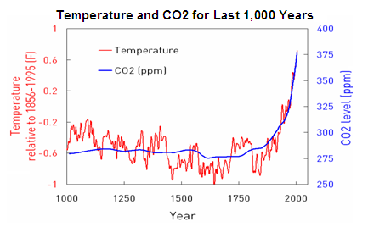
More recent variation in atmospheric CO₂ concentrations and temperature
http://blogs.edf.org/climate411/2007/06/29/human_cause-3/

Slide 16
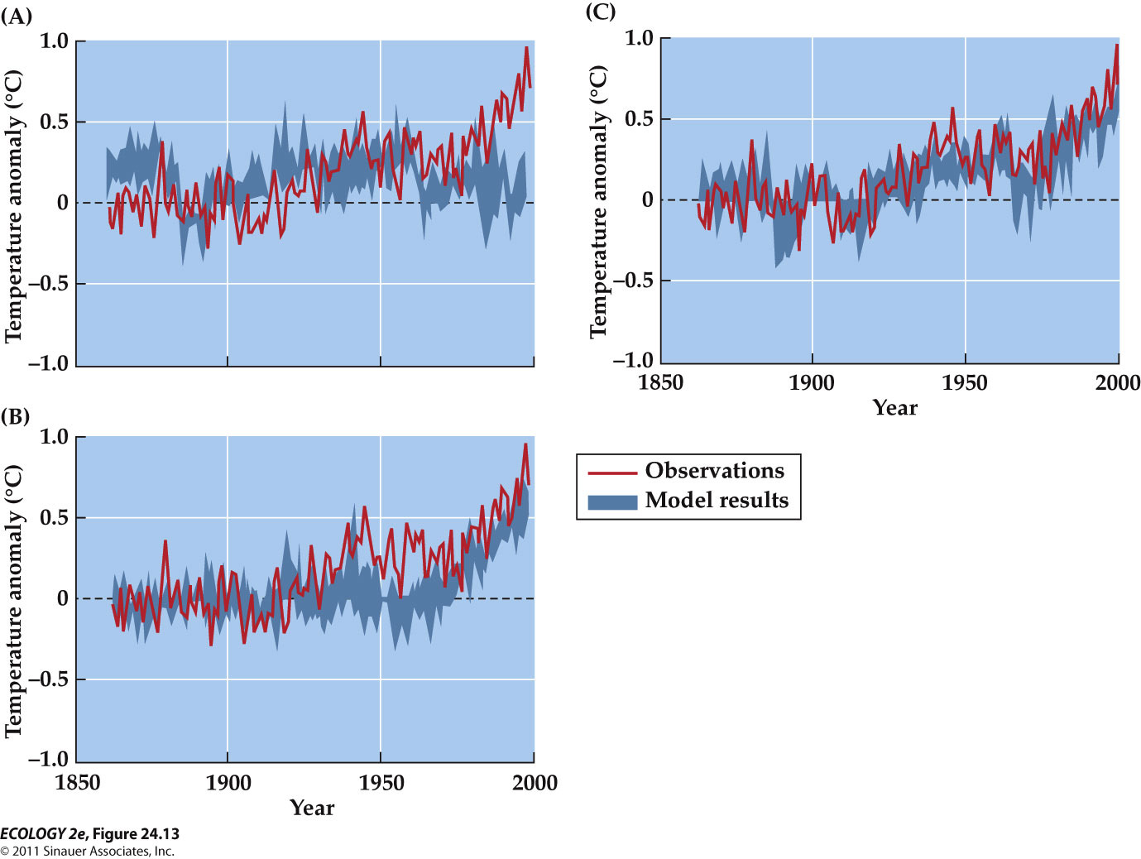
IPCC: Contributors to Global Temperature Change
Natural only: solar radiation & aerosols from volcanic eruptions
Natural and Anthropogenic
Predicted temperature variation with different forcings
Anthropogenic only: greenhouse gas emissions

Slide 17

Referring to those who initially acknowledge global warming but who now deny that it is happening

Slide 18


Slide 19
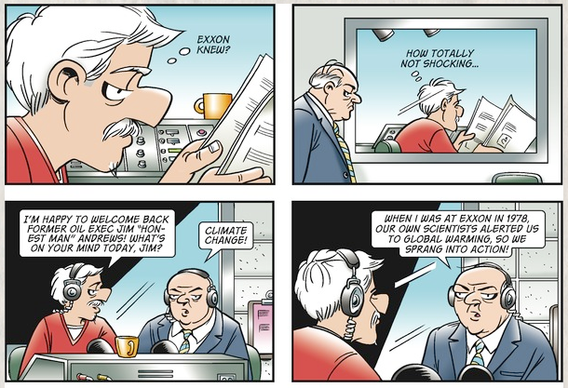
More from Doonesbury…

Slide 20


Slide 21
So, where is the carbon?
Major reservoirs (Pools) in the global carbon cycle
Atmosphere 748 Pg
Terrestrial 2,000 Pg
Oceans 38,000 Pg
Geologic 4,000 Pg
The geologic stores of recoverable fossil fuels were a
relatively inactive reservoir in the global carbon cycle
prior to the industrial revolution and the large-scale use of coal, oil and natural gas
Pg = 10¹⁵ grams

Slide 22
Sources and Sinks (Fluxes) in the Global Carbon Budget: 1980-1995
Fossil fuel combustion 5.7 Pg C/yr
Land-use emissions 1.9 Pg C/yr
Oceans -2.1 Pg C/yr
Atmosphere -3.2 Pg C/yr
“The Missing Sink” 2.3 Pg C/yr
Where is the missing sink?
Houghton 2000. J. Geophys. Res. 105:20121-20130
Notes:
At the global scale, efforts to quantify the carbon budget generally focus on fluxes from these four major pools.
Fossil fuel burning results in the release of C to the atmosphere. Similarly, LU changes, such as clearing forest for agriculture, also releases C. In contrast, the oceans take up a great deal of C. The atmosphere can also be viewed as a “sink” in that the amount of C stored in the atmosphere is increasing. If our flux estimates from each of these pools were accurate, and assuming that there are no other fluxes, these numbers should sum to zero. As you can see, they don’t. This means that there is something else going on. Something else is absorbing a great deal of C. This has been referred to as the “missing sink” and the quest for this missing sink has been the holy grail of global change research for 30 years or so.

Slide 23
Where is the Missing Sink?
Two approaches to finding out:
  Top-down: Atmospheric models that infer the combination of sources and sinks in atmospheric transport models that best match the global spatial and temporal patterns in atmospheric CO₂ data.
  Bottom-up: Land-based approaches using inventory data and ecosystem models.
Most studies suggest large sinks in northern mid-latitudes but the tropics probably also play an important role
Clear need for a better understanding of spatial and temporal variability in C storage and flux at regional scales

Slide 24
Magnitude of the “missing sink”
If the “missing sink” (circa 2000) is equally distributed across all land in the temperate zone of the northern hemisphere, about 0.3-0.58 Pg C/yr should be absorbed in the U.S.. This converts to:
  0.39-0.76 Mg C/ha/yr or
  39-76 g C/m^2/yr or
  about 2 ounces C /m²/yr or
  about 4 ounces of dry plant material per m²/yr

Slide 25
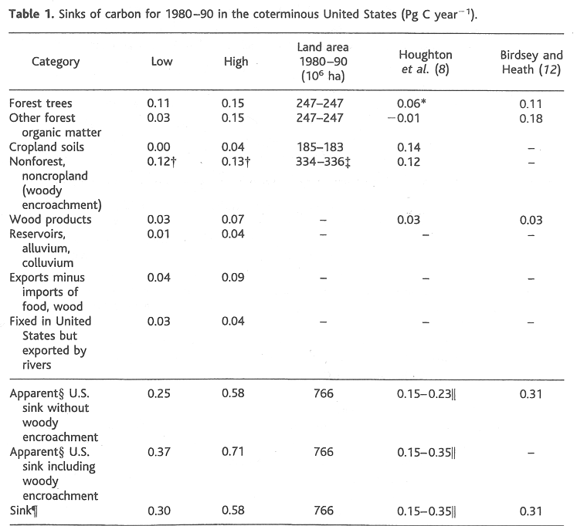
Possible sinks
Total accounted for by items above
This is what is what is needed to balance the C budget for the U.S.
Pacala et al. 2001

Slide 26
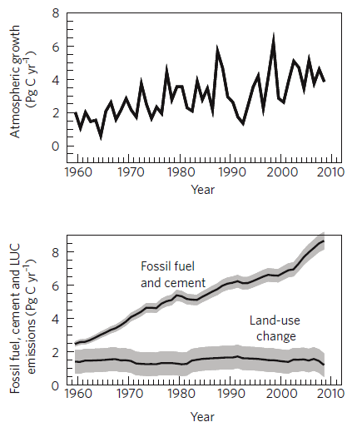
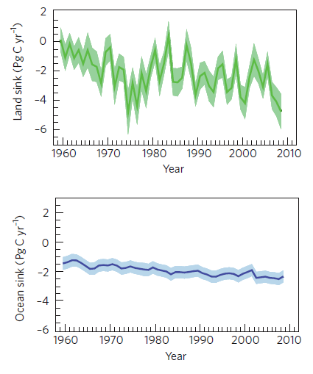
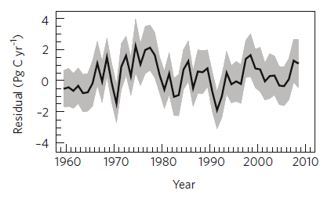
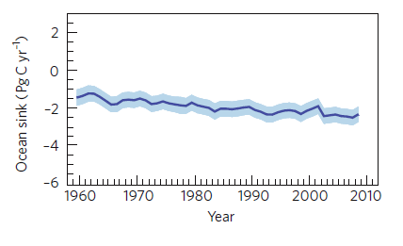
Sources and Sinks in the Global Carbon Budget: 2009
Uptake by land plants is now generally acknowledged as MOST of the “Missing Sink”
“The Missing Sink”
The “Still Missing” Sink
But still lots of “Missing C”
The global C budget does
not balance and residual error is quite variable
Note that uncertainty is greatest for the terrestrial environment
Le Quere, et al., 2009 Nature Geosciences DOI:10.1038/NGEO689
Notes:
We recognize that the magnitude of these fluxes is quite variable in time and we have gotten much better at quantifying this variation. There is still a “missing” carbon (aka: “residual” C) but better flux estimates have reduced its’ size in recent years. The Also note the uncertainty associated with each of the fluxes. The atmosphere and ocean are fairly well mixed so the uncertainty associated with these fluxes is relatively small. Also, given the $$ involved, we have fairly good data on fossil fuel use and cement production. In contrast, note that the uncertainty is quite large for LU change and the land sink (the land sink includes things like the uptake of C by regrowing forests in places like the NE).
In addition to this temporal variability in C flux, we also recognize that there is a great deal of spatial variability in C flux, especially in terrestrial ecosystems.

Slide 27
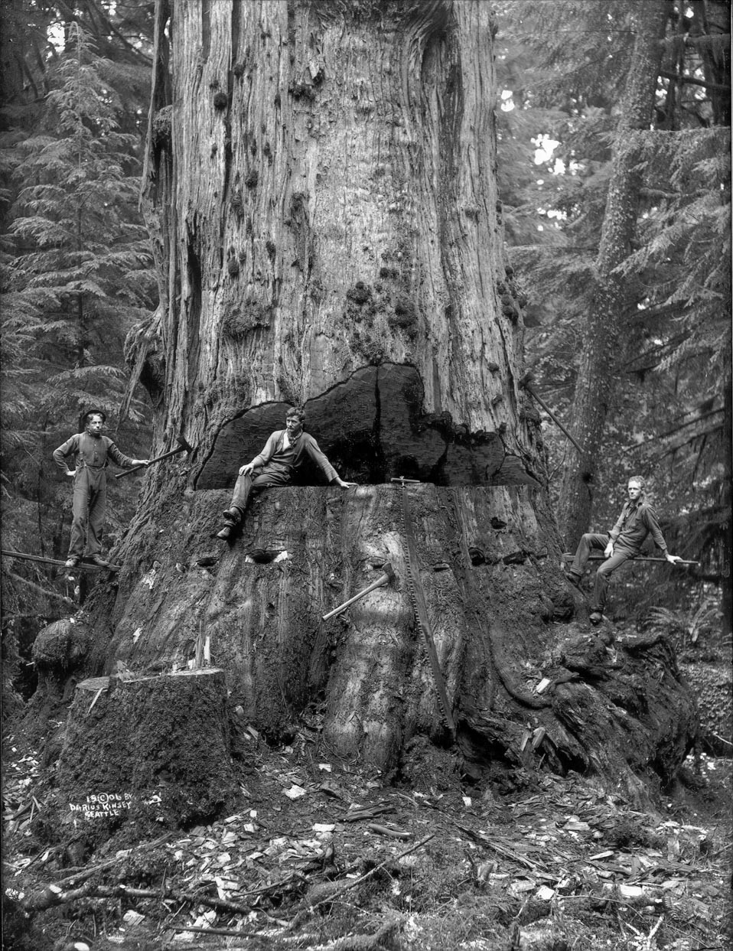
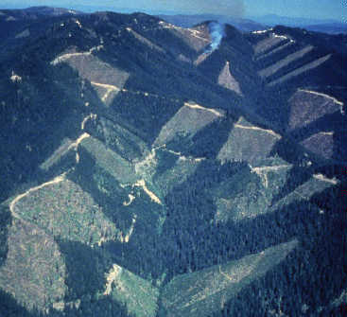
Land-use Impacts on PNW Forests
PNW forests are among the most productive in the world.
These forests have the capacity to store significant amounts of C
Timber harvest activities in this region could have a major impact on C flux.

Slide 28
Recent Changes in Harvest Levels
Notes:
From the 60s through the 80s harvest levels in western OR averaged about 6 billion board feet per year. During this time, harvest on industry land was fairly stable while harvest levels on federal lands were adjusted up and down to track demand that fluctuated with the ups and downs of the economy. Harvest levels during the 80s were quite high and it was widely recognized that these harvest levels were unsustainable, particularly given the increased concern over the impact of timber harvesting on the spotted owl and other oldgrowth dependent species. In the early 90s. Harvest levels on federal lands were reduced by over 90% and they have remained very low ever since. Note that harvest levels on industry and “other” (mostly state and tribal lands) increased a bit during the mid-2000s in response to the building boom and then decreased a bit over the past few years in response to the recession.
It seems likely that these fluctuations in harvest levels have influenced the regional C budget.

Slide 29
An early attempt at a C budget model: Disturbed Forest Carbon Model
Atmosphere
Onsite
Living + Dead
Offsite
Forest Products
Harmon et al. 1990. Science 247:669
Notes:
A variety of models that have been developed to track C storage and flux in forest ecosystems. The DFC model represents one of the earliest examples here in the PNW. The objective for the model was to track the effects of disturbance on C storage and, given the importance of timber harvest in this region, one key objective was to explicitly deal with the fate of C in forest products.

Slide 30
The Evolution of DFC
Standcarb: a stand-level model to examine the effects of site conditions and silviculture on C storage and flux.
Landcarb: a “metamodel” parameterized using Standcarb.
  Quantifies C storage and flux at the landscape to regional scale using satellite imagery to obtain initial stand age and track disturbance.
  Applied at the level of individual grid cells that correspond to the ground resolution of the satellite imagery.
Note that these models focus on the effects of timber harvest rates and silvicultural practices on C flux.
These models are not intended to capture the effects of inter-annual climate variability, or climate change, on C storage or flux.
Notes:
Over the years, the DFC model has evolved into a series of models. Quantifying carbon dynamics at the landscape and regional scale requires the use of a model that captures the spatial and temporal complexities in terrestrial systems
Satellite data can provide information on spatial and temporal heterogeneity
A detailed stand-level model (STANDCARB) is used to parameterize a simplified “metamodel” that can be applied to individual grid cells corresponding to the ground resolution of the satellite imagery.

Slide 31
Landcarb: Earlier Applications
Study Area:
  Central Oregon Cascades: Cohen et al. 1996, Wallin et al. 1996
Data:
  Stand Age: Landsat data used to identify 6 age classes during 1972 and 1988 (Cohen et al., 1992, 1995)
  Disturbance: difference-based approach to identify timber harvest and fire using Landsat data at 3-7 year intervals covering 1972-1995. (Cohen et al., 1998, 2002)
Notes:
Quantifying carbon dynamics at the landscape and regional scale requires the use of a model that captures the spatial and temporal complexities in terrestrial systems
Satellite data can provide information on spatial and temporal heterogeneity
A detailed stand-level model (STANDCARB) is used to parameterize a simplified “metamodel” that can be applied to individual grid cells corresponding to the ground resolution of the satellite imagery.

Slide 32
Landcarb: Current Applications
Study Area: All of Western Oregon (Cascades and Coast Range) 4.9 million hectares
Data:
  Stand Age: same as earlier applications (Cohen et al., 1992, 1995)
  New Disturbance Layer (Landtrender): trajectory-based approach using Landsat data (annual time step) from 1985-2008. (Kennedy et al. 2007, 2010)
Notes:
Quantifying carbon dynamics at the landscape and regional scale requires the use of a model that captures the spatial and temporal complexities in terrestrial systems
Satellite data can provide information on spatial and temporal heterogeneity
A detailed stand-level model (STANDCARB) is used to parameterize a simplified “metamodel” that can be applied to individual grid cells corresponding to the ground resolution of the satellite imagery.

Slide 33
Carbon Storage following the disturbance of an old-growth stand
Total
Live
Dead
Forest Products
Site Index 3
Notes:
Decay rate for dead: 3%/yr
Decay (loss) rate for forest products: 0.85%/yr
At harvest, 50% of the pre-harvest living pool gets added to the dead pool and remains onsite.
Of the 50% of the pre-harvest living pool that leaves the site on logging trucks, 40% is lost to the atmosphere during the first year due to losses during primary and secondary manufacturing. The remaining 60% (30% of the pre-harvest living pool; 0.5*0.6=0.3 or 30%), goes into forest products with a relatively long lifetime. However, even these long-lived forest products don’t last forever and these are lost at a rate of 0.85% per year.

Slide 34
Carbon Storage following the disturbance of an old-growth stand
States vs. Rates
Total
Live
Dead
Forest Products
Site Index 3
Notes:
Decay rate for dead: 3%/yr
Decay (loss) rate for forest products: 0.85%/yr
At harvest, 50% of the pre-harvest living pool gets added to the dead pool and remains onsite.
Of the 50% of the pre-harvest living pool that leaves the site on logging trucks, 40% is lost to the atmosphere during the first year due to losses during primary and secondary manufacturing. The remaining 60%, 30% of the pre-harvest living pool (0.5*0.6=0.3 or 30%), goes into forest products with a relatively long lifetime. However, even these long-lived forest products don’t last forever and these are lost at a rate of 0.85% per year.

Slide 35
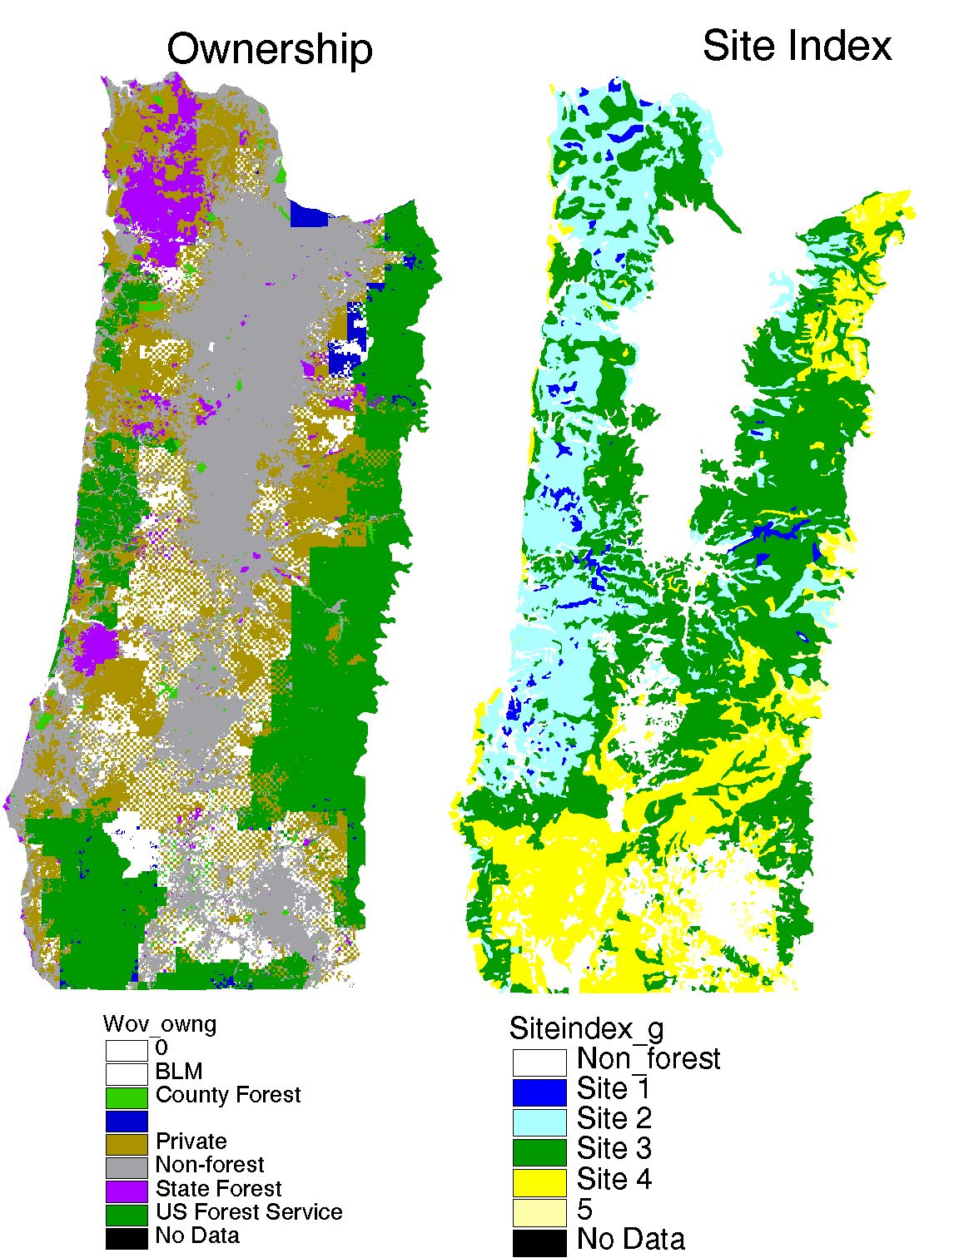

Slide 36
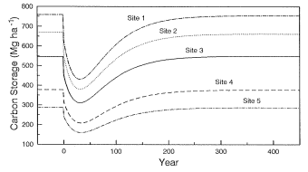

Slide 37

Results
Average Net Flux from 1972-2008: Source for 0.29 Mg C/ha/yr
Positive values represent flux TO the atmosphere (source)
Negative values represent flux FROM the atmosphere (sink)
Notes:
Here are my results. The model quantifies flux for each of the major C pools. Onsite flux is the sum of live and dead flux. Offsite flux tracks the fate of C in the forest products sectors. Total flux is the sum of onsite and offsite flux. In all of these graphs, a positive flux represents a net release of C to the atmosphere (a source) and a negative flux indicates a net uptake of C from the atmosphere (a sink). The red line represents the results of running the model using Warren Cohen’s difference-based disturbance layer. This difference-based layer maps disturbance at 3-7 year intervals for the period from 72-95. I also ran the model using just the Landtrender disturbance layer that maps disturbance annually for the period from 85-2008.
Note that, for the purpose of this analysis, I don’t distinguish between timber harvest and fire. Although fire and timber harvest have different effects on C flux, I didn’t feel that it was necessary to add this detail to the model since, in most years, the amount of fire was trivial compared with the amount of timber harvest. The one glaring exception to this was 2002 when the Biscuit fire burned ~500,000 acres in southern OR. Note the huge spike in C flux in response to this fire.
Examining each of these graphs:
Live: note that, in most years, the living pool is a net sink for C. The years when the living pool is a source occur when the harvest rate (and/or burn rate) exceeds the rate of regrowth.
Dead: In most years, the dead pool is a source in that the decay rate exceeds the rate of conversion of living C to dead C
Offsite: Always a net sink in that the addition of C to this pool has always exceeded the loss rate from this pool.
Total: During the 70s and 80s, the high harvest rate generally resulted in a net release of about 1 Mg C/ha/yr. During the 90s, the region absorbed about 0.5 Mg C/ha/yr. The 2002 fire caused a short spike in C emissions and, over the past few year, C-flux has been just slightly negative (sink).
Over the entire 36 year period, the region has been a net source for 0.29 Mg C/ha/yr.

Slide 38
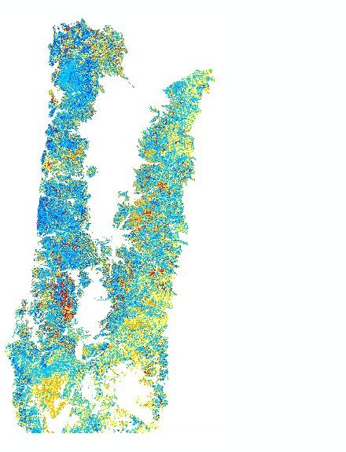
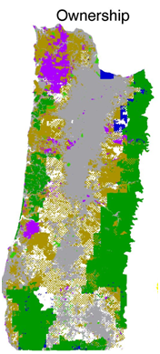

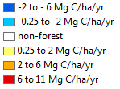
Source for 0.29 Mg C/ha/yr from 1972-2008
Net C Flux
Ownership
Notes:
The left panel presents the spatial pattern of C flux fro the entire 36 year interval. As you can see, there is considerable spatial variability in C flux. The biggest patches of C source are on private lands in the cascades and the coast range. USFS lands include both sources and sinks.
Note that there seems to be quite a lot of blue on the C-flux map. Most of the area appears to be a slight sink. However, there is a fair amount of yellow and a bit of bright red. These are the sources; the areas that are losing carbon.

Slide 39
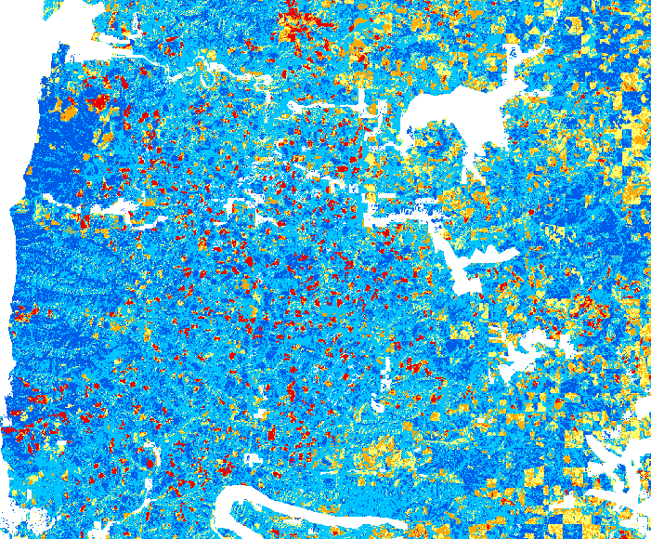
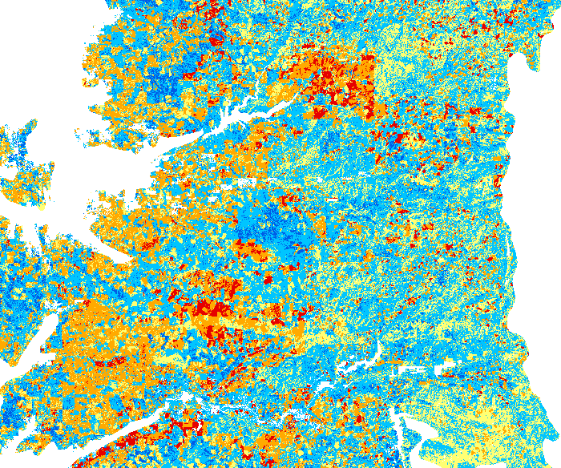
Timber Harvest

Slide 40
Results
Average Net Flux from 1972-2008: Source for 0.29 Mg C/ha/yr
Positive values represent flux to the atmosphere
Notes:
Here are my results. The model quantifies flux for each of the major C pools. Onsite flux is the sum of live and dead flux. Offsite flux tracks the fate of C in the forest products sectors. Total flux is the sum of onsite and offsite flux. In all of these graphs, a positive flux represents a net release of C to the atmosphere (a source) and a negative flux indicates a net uptake of C from the atmosphere (a sink). The red line represents the results of running the model using Warren Cohen’s difference-based disturbance layer. This difference-based layer maps disturbance at 3-7 year intervals for the period from 72-95. I also ran the model using just the Landtrender disturbance layer that maps disturbance annually for the period from 85-2008.
Note that, for the purpose of this analysis, I don’t distinguish between timber harvest and fire. Although fire and timber harvest have different effects on C flux, I didn’t feel that it was necessary to add this detail to the model since, in most years, the amount of fire was trivial compared with the amount of timber harvest. The one glaring exception to this was 2002 when the Biscuit fire burned ~500,000 acres in southern OR. Note the huge spike in C flux in response to this fire.
Examining each of these graphs:
Live: note that, in most years, the living pool is a net sink for C. The years when the living pool is a source occur when the harvest rate (and/or burn rate) exceeds the rate of regrowth.
Dead: In most years, the dead pool is a source in that the decay rate exceeds the rate of conversion of living C to dead C
Offsite: Always a net sink in that the addition of C to this pool has always exceeded the loss rate from this pool.
Total: During the 70s and 80s, the high harvest rate generally resulted in a net release of about 1 Mg C/ha/yr. During the 90s, the region absorbed about 0.5 Mg C/ha/yr. The 2002 fire caused a short spike in C emissions and, over the past few year, C-flux has been just slightly negative (sink).
Over the entire 36 year period, the region has been a net source for 0.29 Mg C/ha/yr.

Slide 41
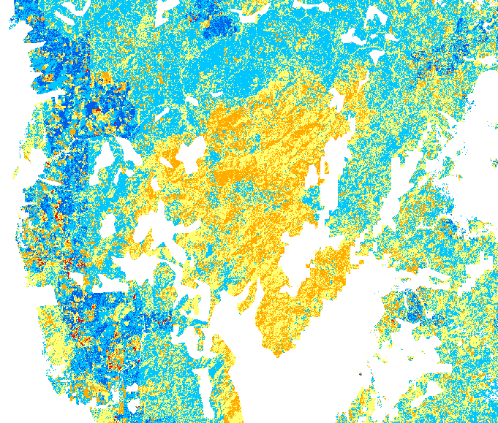
Fire Impacts
The Biscuit Fire: (2002) ~500,000 acres

Slide 42
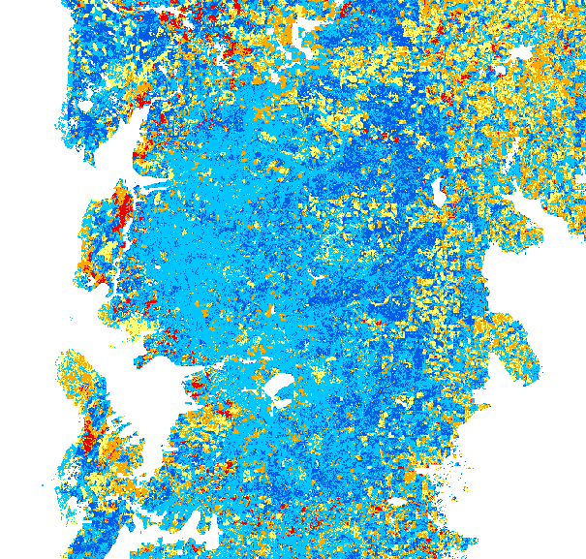
Fire Impact Legacies
The Tillamook Burn: (1933-51) ~350,000 acres

Slide 43
Carbon Storage following the disturbance of an old-growth stand
Tillamook Burn was in this part of the curve during 1972-2008
Total
Live
Dead
Forest Products
Site Index 3
Notes:
Decay rate for dead: 3%/yr
Decay (loss) rate for forest products: 0.85%/yr
At harvest, 50% of the pre-harvest living pool gets added to the dead pool and remains onsite.
Of the 50% of the pre-harvest living pool that leaves the site on logging trucks, 40% is lost to the atmosphere during the first year due to losses during primary and secondary manufacturing. The remaining 60%, 30% of the pre-harvest living pool (0.5*0.6=0.3 or 30%), goes into forest products with a relatively long lifetime. However, even these long-lived forest products don’t last forever and these are lost at a rate of 0.85% per year.

Slide 44
Effect of Mid-2000’s housing bubble

Slide 46
Notes:
Largest release of C is coming from private lands; largest sinks on state lands

Slide 47
Model Validation
Tg = teragram = 10¹² grams
Notes:
Model underestimates C harvest by about 20%. Biggest error may be in Coast Range and in how we deal with hardwoods; we model hardwood dominated stands as having an age of 20-30 years but, in the Coast Range, these stands may be 60-80 yrs of age.

Slide 48
Effect of Rotation Length on Carbon Storage

Slide 49
Conclusions
Carbon flux in PNW forests has been highly responsive to timber harvest
  Source for ~ 1 Mg C/ha/yr during the 70s-80s
  Sink for ~0.5 Mg C/ha/yr during the 90s
  Modest reduction in sink due to building boom in the mid-2000s
Given the low harvest rates on federal lands, the region is likely to continue to be a slight sink during the coming decade….or maybe not if harvest rates increase
The Biscuit fire had a major impact on the regional C budget that swamped the effects of harvest (but refinements needed to clarify magnitude of effect)
Shift to longer rotations could result in significant C sequestration.

