Slide 1
Flying the 3DR Solo with the
Sidepilot App

Slide 2
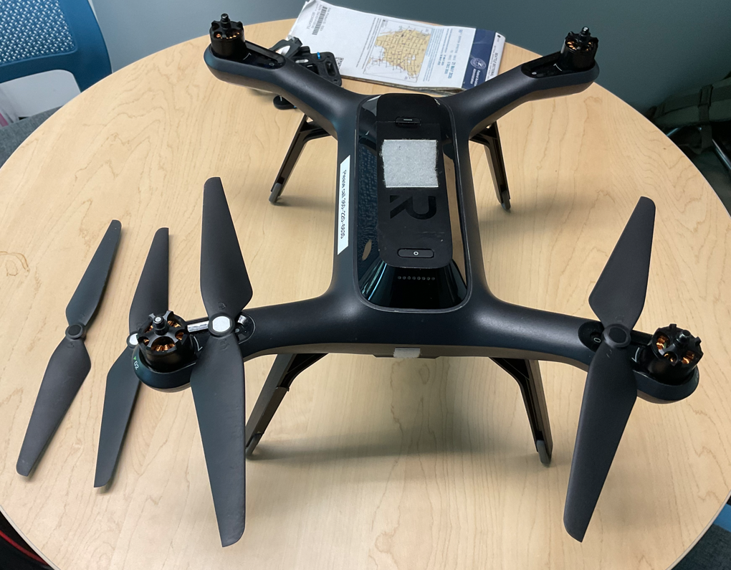
Install props: note that some prop have silver in middle and others have black center. Silver ones go on the motor with silver dot. Black ones go on motors with black dot. Note symbol on prop showing which way to turn to screw them on. And note that black and silver props will rotate in opposite direction.

Slide 3
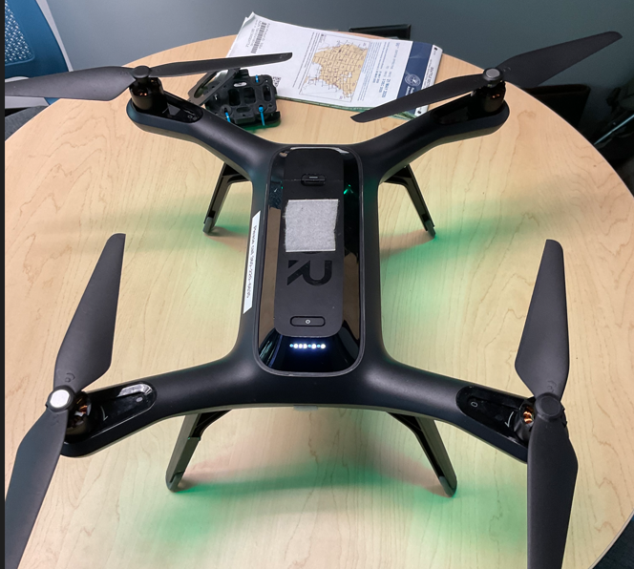
Push and hold to power on; hold until string of white lights (below button) come on and you hear a happy string of beeps. If battery is fully charged, all lights in this string will come on (some may be a bit dim and this is OK)
This button allows you to remove battery by sliding This way

Slide 4
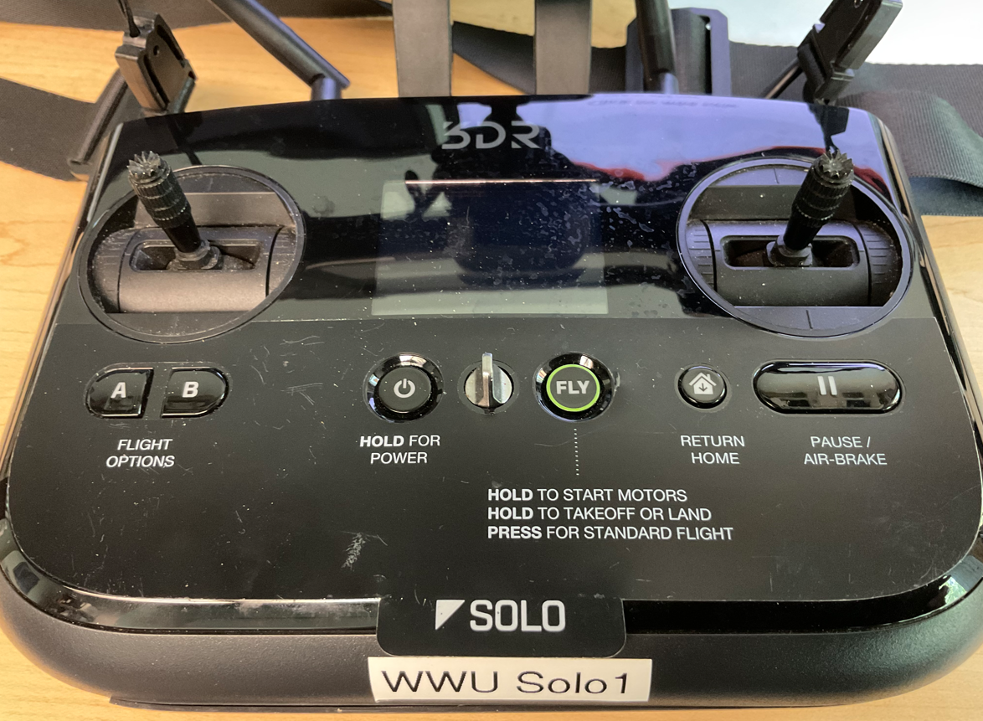
Push and hold to power on; hold until you feel a slight “thunk” and screen will light up

Slide 5
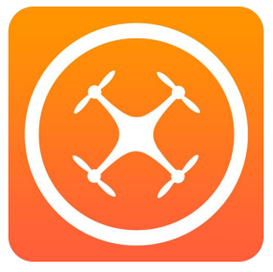
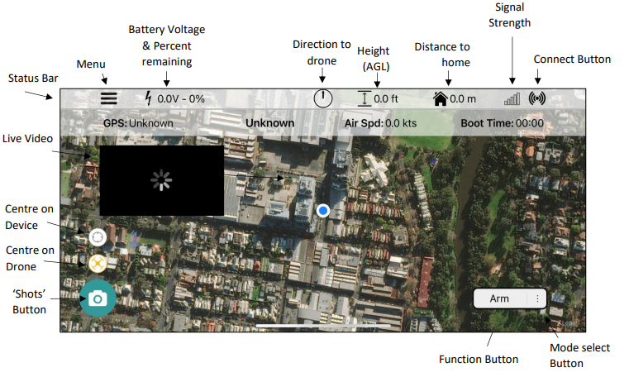
Sidepilot App
Power on iPad:
PW: gnss2!
Go to sidepilot app
Select 3DR Solo
Go to Settings/Wifi on ipad and select:
  One of the WWU WIFI sites
Go back to Sidepilot and you should see a map of campus that may be pretty blurry. This is OK

Slide 6
Sidepilot App
Now go back to to Settings/Wifi on ipad and select:
  SoloLink_solo#
  PW: sololinksolo#
  # is the number of your solo
Go to sidepilot app
Select 3DR Solo
On Sidepilot main screen, hit the Connect Button. It will turn blue when connected

Slide 7
Sidepilot App
Select
You should now see your location on the map
You are now ready to take off.

Slide 8
Flight Controls
BEFORE YOU TAKE OFF
Familiarize yourself with control sticks
This is the vertical speed control
  Push forward to go up; farther you push it the faster you go up
  Pull back to go down; farther you pull it the faster you go down
  Let go and the drone will hover

Slide 9
Flight Controls
Yaw control
  Push to right and drone will rotate (yaw) to the right; farther you push it the faster it will rotate
  Push to the left and the drone will rotate (yaw) to the left; farther you push it the faster you will rotate
  Let go and drone will hover

Slide 10
Flight Controls
Roll control
  Push to right and drone will roll (slide) to the right. It will not roll over; just slide to right; farther you push it the faster it will slide to right
  Push to left and drone will slide to left; farther you push it the faster it will go
  Let go and drone will hover

Slide 11
Flight Controls
Forward/back control
  Push forward to go forward; farther you push it the faster you go
  Pull back to move backwards; farther you push it the faster you go
  Let go and you will stop and hover

Slide 12
Flight Controls
Don’t panic!
Recall that if you let go of both sticks, the drone will immediately stop in mid air and hover

Slide 13
Flight Controls
When ready to land,
Maneuver into position over landing location,
SLOWLY, pull back on vertical speed control and SLOWLY bring it down to the ground.
WHEN THE DRONE IS ON THE GROUND (NOT BEFORE!), PULL STICK ALL THE WAY BACK TO SHUT OFF MOTORS.

Slide 14
Flight Controls: Take off
When ready to take off:
  Push and hold the “Fly” button and watch screen, a green bar will slide across screen. Let go of fly button
  Push vertical speed control forward to take off
Go ahead and land and take off a few times to get a feel for it.
Then go ahead and fly around……CAREFULLY and SLOWLY!
Don’t try to get too fancy or too rambunctious. Just get a feel for maneuvering around
MONITOR THE BATTERY LEVEL AND LAND WITH AT LEAST 25% BATTERY LEFT. You should get about 10 -12 minutes of flight time on a battery

Slide 15
Flying: Things to try
Use smooth, modest control inputs; don’t pump the sticks
When flying away; right is right and left is left
When flying towards you, roll stick to right will make the drone slide to your left! Control inputs reversed. It takes practice to train your brain to sort this out! You need to learn to mentally put yourself in the drone
Coordinated turns: Try a bit of yaw as you move forward slowly to keep drone facing forward into turn. Need to coordinate amount of forward motion with amount of yaw.
Figure 8’s: requires you to alternate yaw to right and then left as you trace a figure 8 pattern. Also helps you learn the reversal of control inputs as you head away, then towards yourself.
STAY AHEAD OF THE DRONE! Think about where you are heading and make sure path is clear.
Don’t fly over people!

